Slide 2
Data visualization in Python
Cindy van de Vries – Safavi Nic & Dave de Koning

Slide 3
Time schedule
16:00-16:30 | Introduction + installation | Dave
16:30-17:30 | Ex1 (last 15 minutes discussion of exercise) | Cindy
17:30-18:00 | Dinner | All
18:00-19:00 | Ex2 (last 15 minutes discussion of exercise) | Dave
19:00-20:00 | Ex3 (last 15 minutes discussion of exercise) | Cindy

Slide 4
Type of plots
Time series
Spatial maps
2D graphs
Categorical plots
Bar charts
Longitudinal charts

Slide 5


Ways of plotting
alt.Chart(source).mark_line().encode( x='x', y='f(x)' )
Using predefined functions (Code):
Line
Bar
Scatter
In a declarative way
Based on data
Style the figure

Slide 6
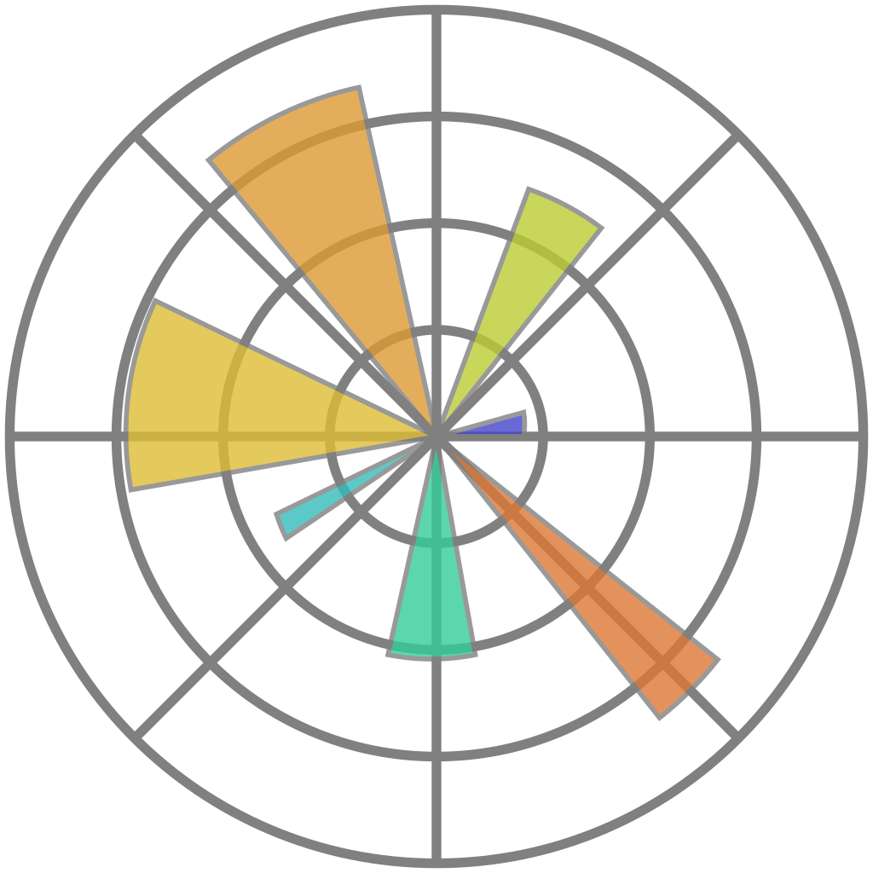

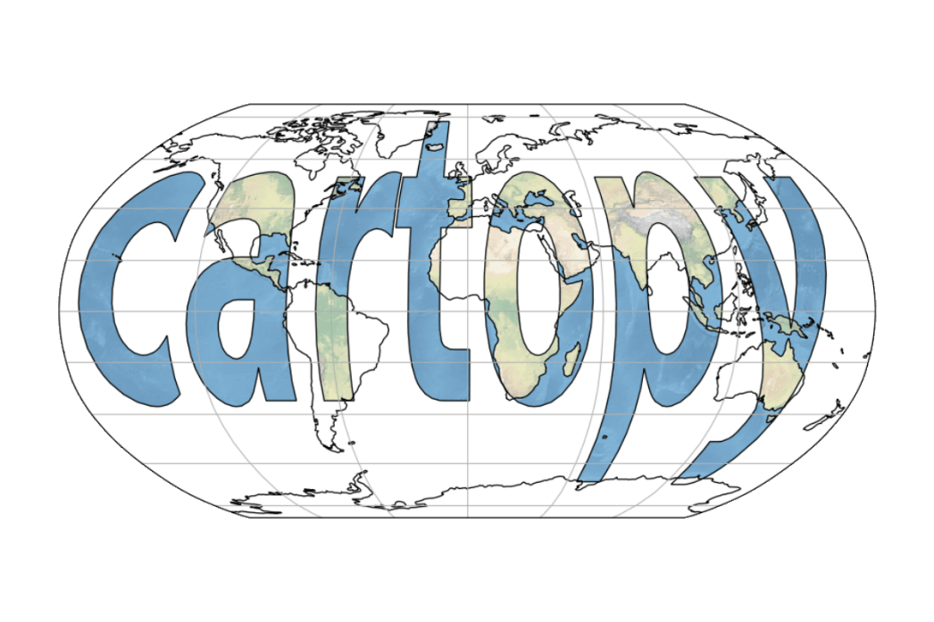



Packages
Matplotlib
Bokeh
Seaborn
ggplot
Cartopy
Altair
Holoviews
MetPy
Plotly

Slide 7
Basic plot

Slide 8
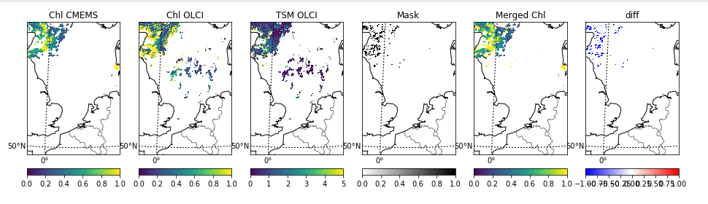

Slide 9
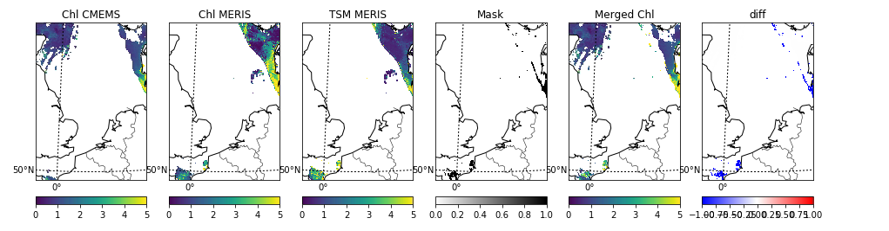

Slide 10
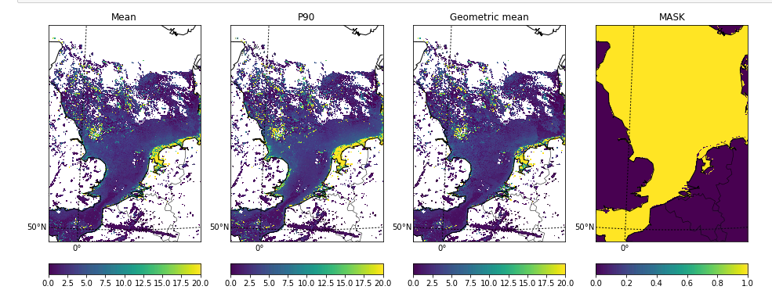

Slide 11
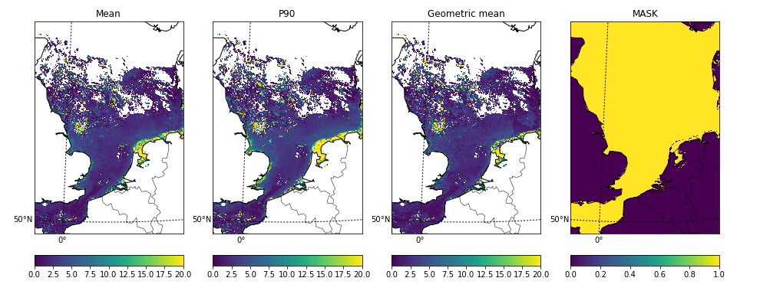

Slide 12
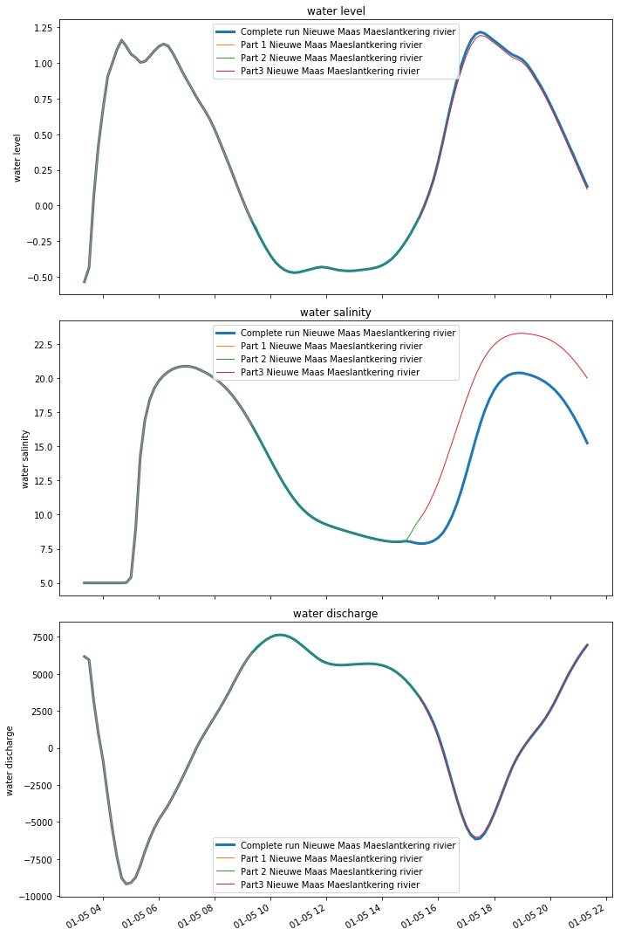

Slide 13
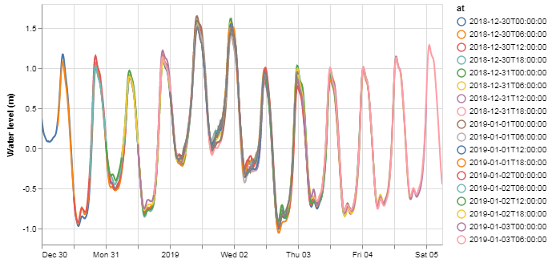

Slide 14
Before we begin
Information at: https://github.com/openearth/et-pizza-courses
We have set up an environment:
Start the Anaconda prompt or Anaconda navigator
In Anaconda navigator, navigate to the tab “Environments” on the left of the screen.
Subsequently select import at the bottom
Provide a name, e.g. “pizza_course_vis”
And navigate to the file “3. Visualizations\environment.yml”
In Anaconda prompt run the command:
conda env create -f “3. Visualizations\environment.yml”
This might take about 5 minutes

Slide 15
Before we begin
To actually run the notebooks in this environment please follow the next steps:
In Anaconda navigator
Select the home tab and start the Jupyter notebooks (make sure the correct environment is selected at the top)
When the notebook opens in the browser navigate to the correct folder and open Ex1
In Anaconda prompt run the following commands
conda activate pizza_course_vis
jupyter notebook
When the notebook opens in the browser navigate to the correct folder and open Ex1

Slide 16
If you want to be stubborn…
You can also add the following packages to an existing environment
Pandas
Numpy
Matplotlib
Bokeh
Cartopy
Note that for the course python 3.7 was used which has a major change in the way you can start conda/python. It is advised to always start either through Anaconda navigator or Anaconda prompt.

